Slide 1
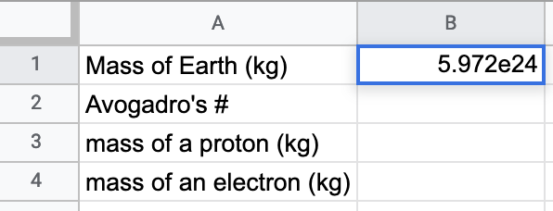
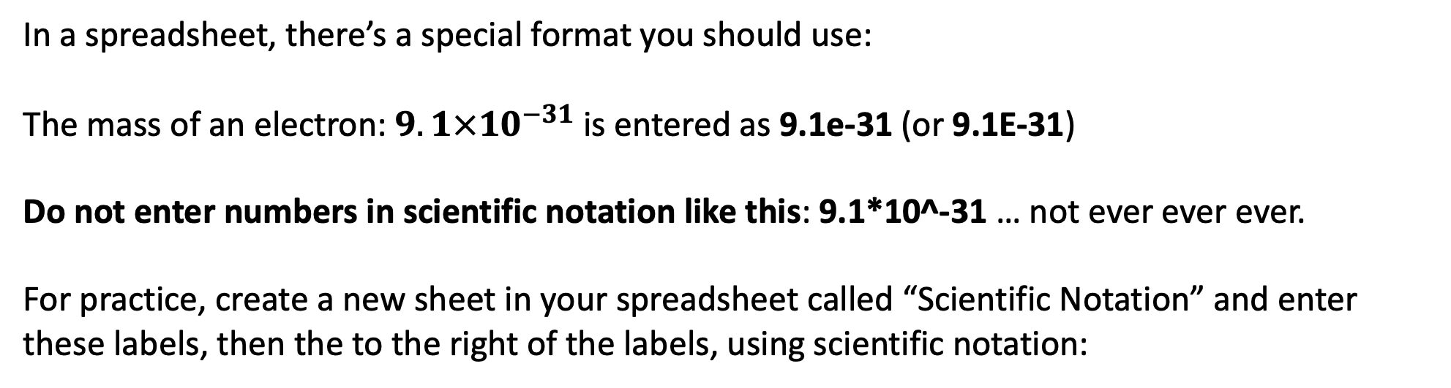
Scientific notation
In a spreadsheet, there’s a special format you should use:
The mass of an electron: $9.1×{10}^{−31}$ is entered as 9.1e-31 (or 9.1E-31)
Do not enter numbers in scientific notation like this: 9.1*10^-31 … not ever ever ever.
For practice, create a new sheet in your spreadsheet called “Scientific Notation” and enter these labels, then the to the right of the labels, using scientific notation:

Slide 2
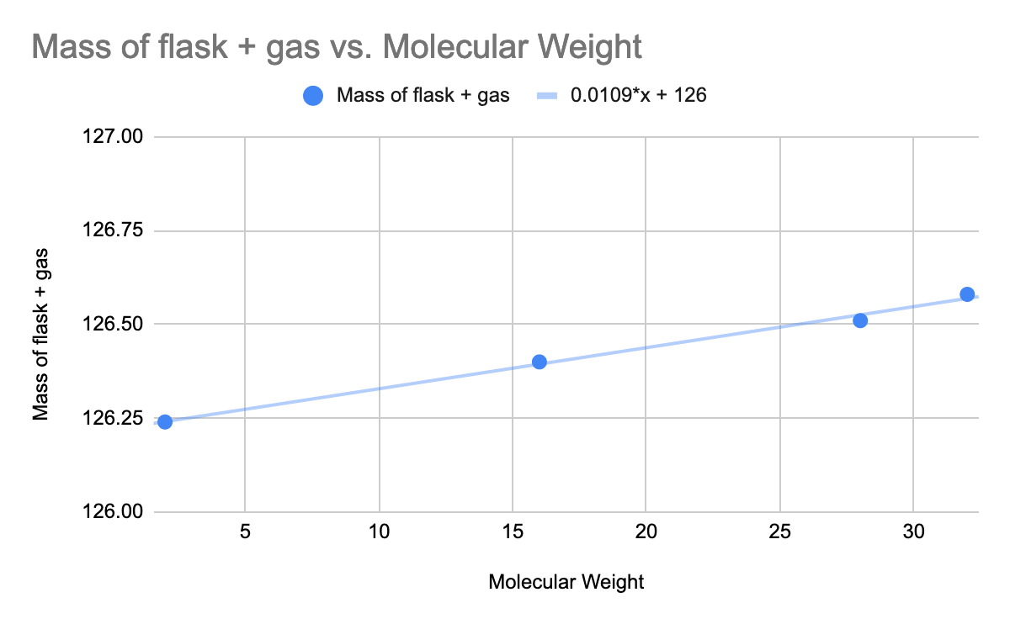
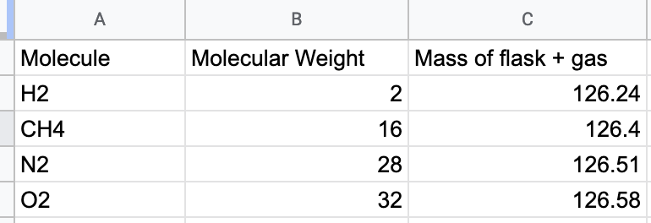
Graphing and line fitting
Say we’ve measured the mass of an Erlenmeyer flask that contains different types of gas, and we want to see what the mass looks like as a function of MW:
See customize … series … trendline … use equation

Slide 3

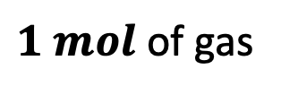
Key equation: the Ideal Gas Law
$n=\frac{PV}{RT}$
$1 mol$ of gas
Some explanation:
Enter these values into your spreadsheet.

Slide 4
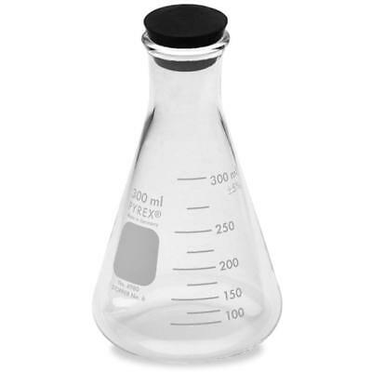
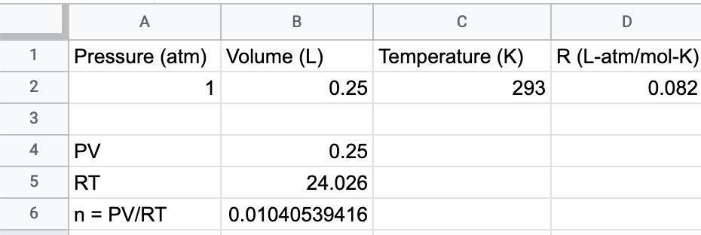
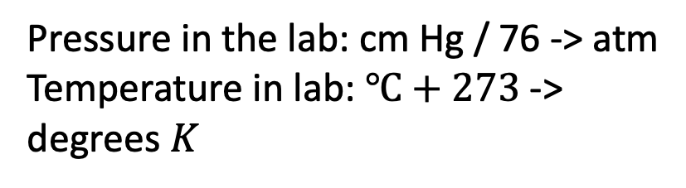
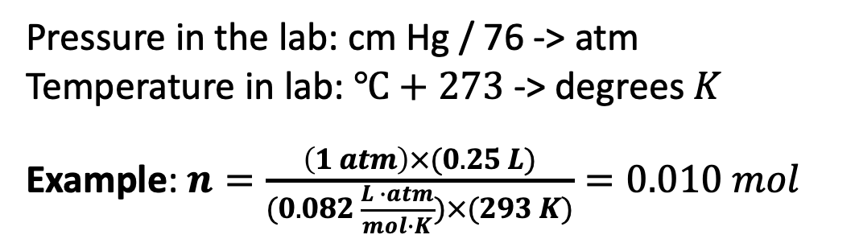
Key equation: the Ideal Gas Law
$n=\frac{PV}{RT}$
Pressure in the lab: cm Hg / 76 -> atm
Temperature in lab: $℃+273$ -> degrees $K$
Pressure in the lab: cm Hg / 76 -> atm
Temperature in lab: $℃+273$ -> degrees $K$
Example: $n=\frac{\left(1 atm\right)×(0.25 L)}{(0.082 \frac{L ∙atm}{mol∙K})×(293 K)}=0.010 mol$
Some explanation:
Enter these values into your spreadsheet.

Slide 5

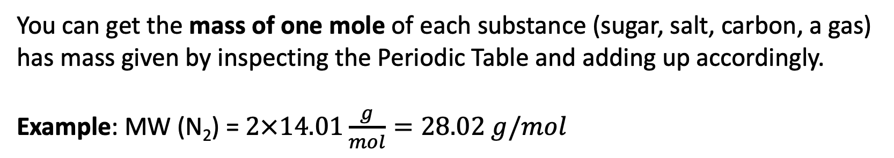
Interpretation of Molecular Weight and Atomic Weight
You can get the mass of one mole of each substance (sugar, salt, carbon, a gas) has mass given by inspecting the Periodic Table and adding up accordingly.
Example: MW (N₂) = $2×14.01\frac{g}{mol}=28.02 g/mol$
Some explanation:
Enter these values into your spreadsheet.

Slide 6
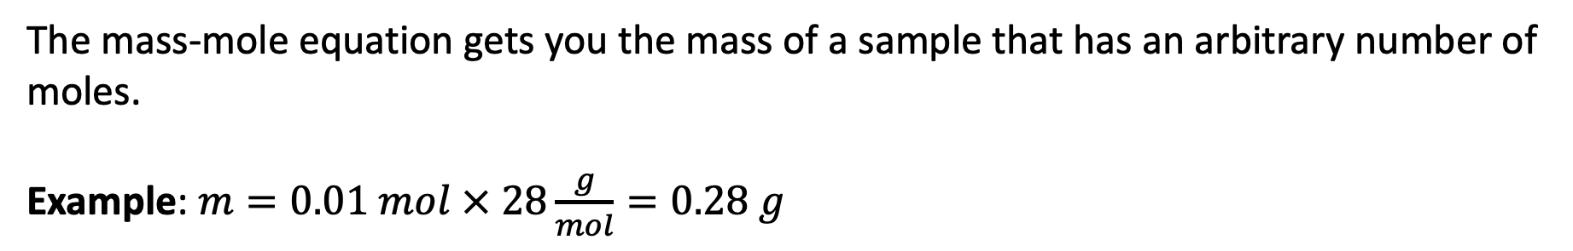
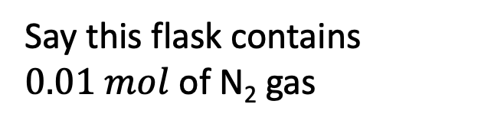
Key equation: the Mass Mole Equation
$$m=n × MW$$
Say this flask contains $0.01 mol$ of N₂ gas
The mass-mole equation gets you the mass of a sample that has an arbitrary number of moles.
Example: $m=0.01 mol × 28\frac{g}{mol}=0.28 g$
Some explanation:
Enter these values into your spreadsheet.

Slide 7
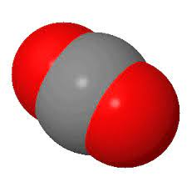
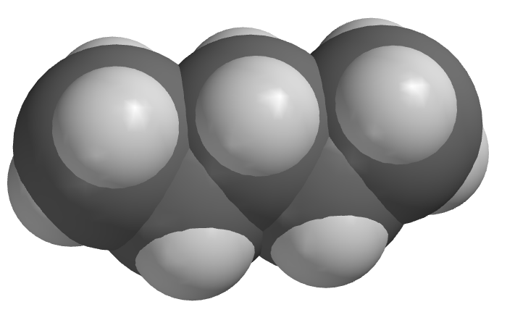


Forms of carbon in the climate system
Carbon Dioxide and methane
Bicarbonates
1-
$$Na^{+}$$
Carbonates and hydrocarbons
$${Ca}^{2+}$$
2-

Slide 8
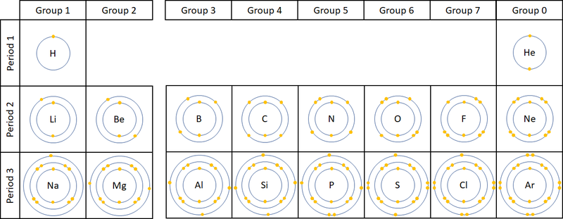
Groups and typical charges: Alkali metals, Alkali Earth metals, Oxygen family, Halogens

Slide 9
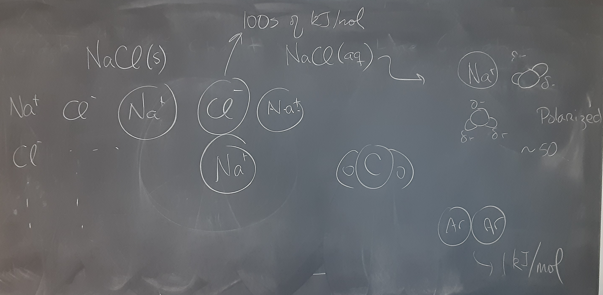
Comparison of binding strengths

Slide 10
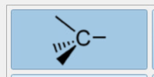
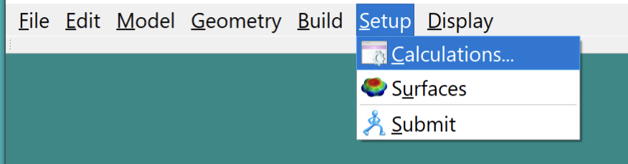
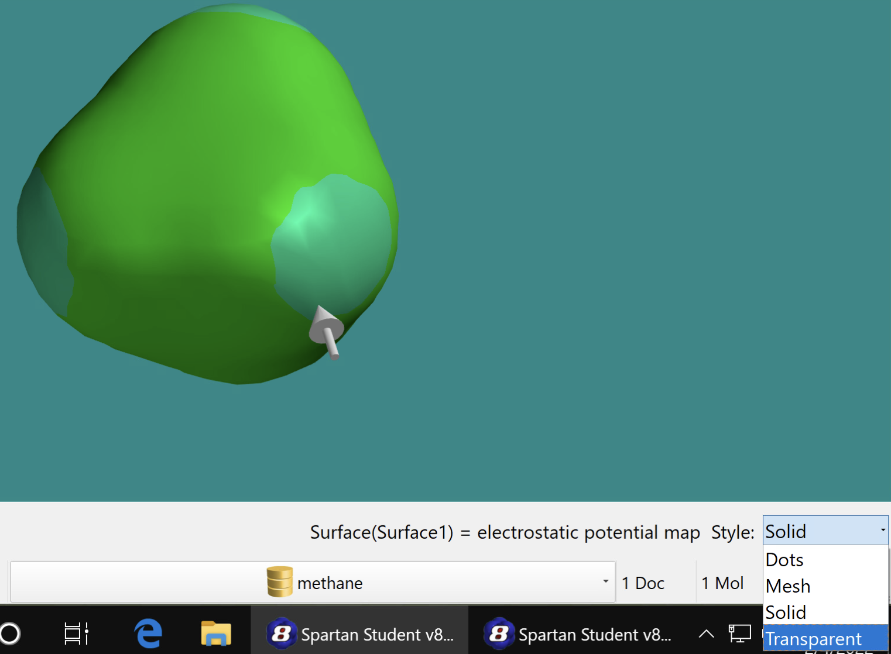
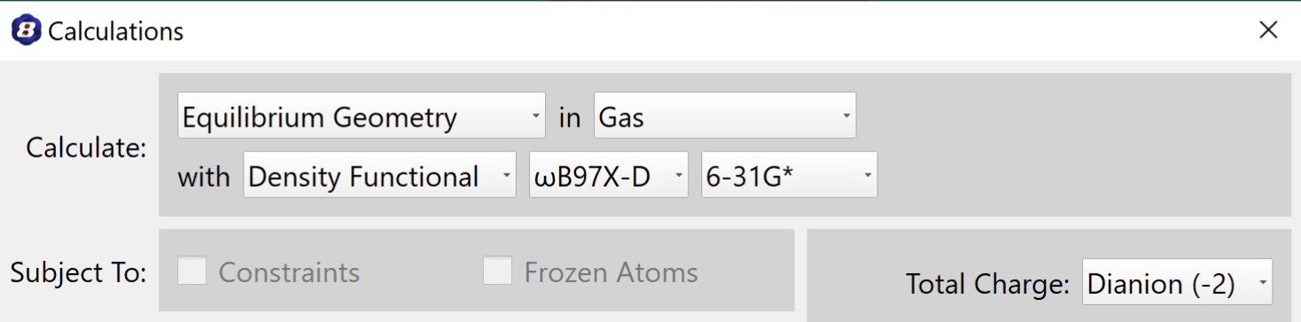
Using Spartan to build carbon-containing molecules
In Spartan …
File/New Build, select methane from the organic palette, and double click in the middle of the green area to put it there.
Go to Setup and:
Inside Calculations and press Submit.
When Spartan tells you it’s finished, return to Setup and select Submit and then add an Electrostatic Potential Surface.
It’s handy to make the display style transparent.
Sketch the result in your notebook, noting especially the colors.
Repeat for water, carbon dioxide, and the carbonate ion. (carbonate will require that you specify a total charge of -2).

